Slide 1
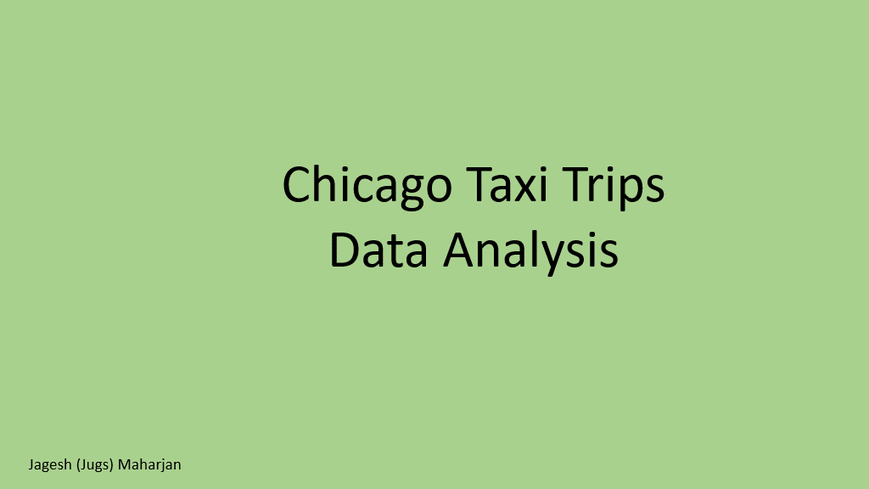

Slide 2
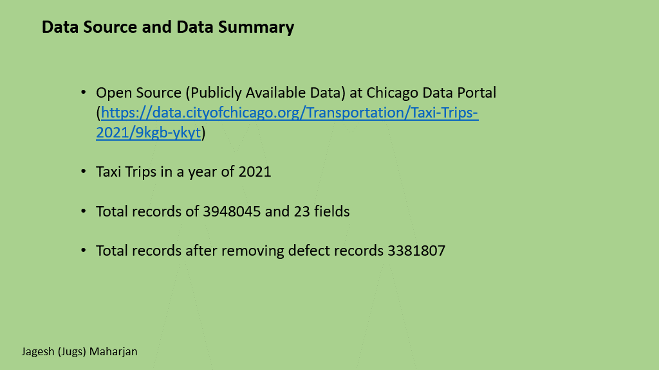

Slide 3
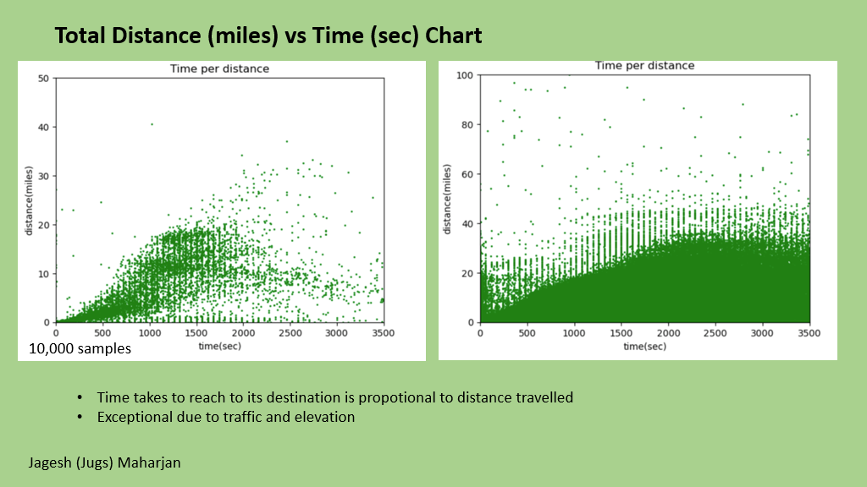

Slide 4

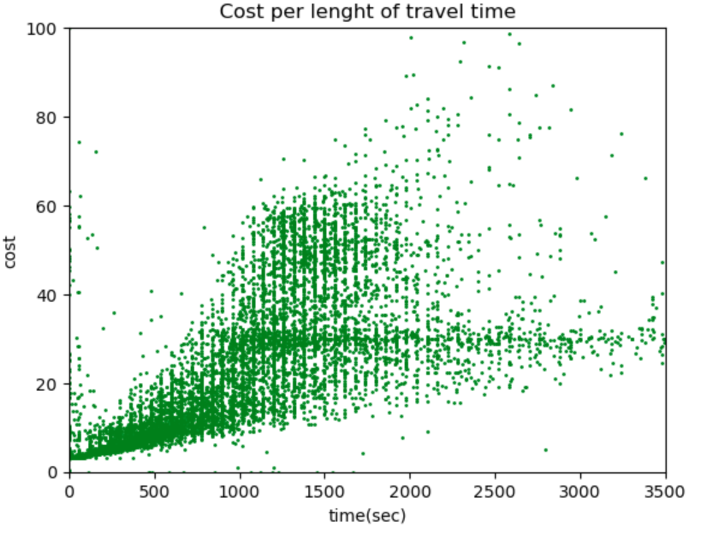
Cost of trip vs Time Travelled
Cost of taxi trip is directly proportional to time it travelled
Including some factors for some high and low cost of the taxi trips

Slide 5
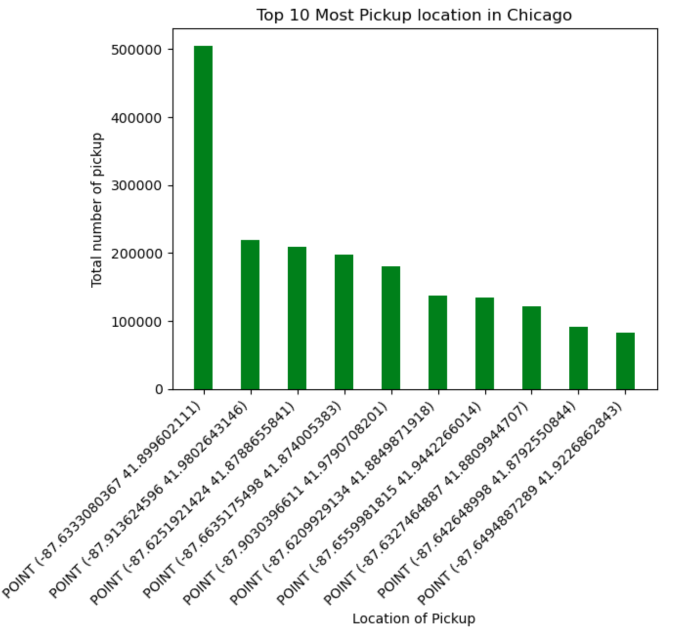
Top 10 Most picked up Geo-coordinate in year 2021
Total numbers of pickup at geo-coordinate (-87.63330803, 41.89960211) is 500,000 in a year 2021

Slide 6
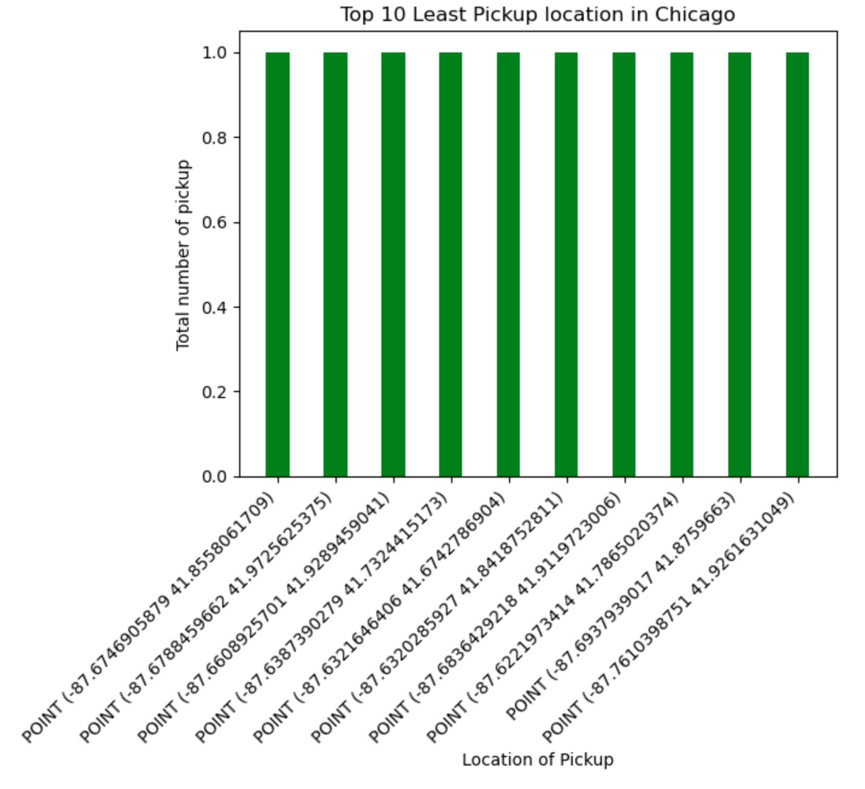
Top 10 Least picked up Geo-coordinate in year 2021
Certain locations have only 1 pickup by far throughout the year 2021

Slide 7
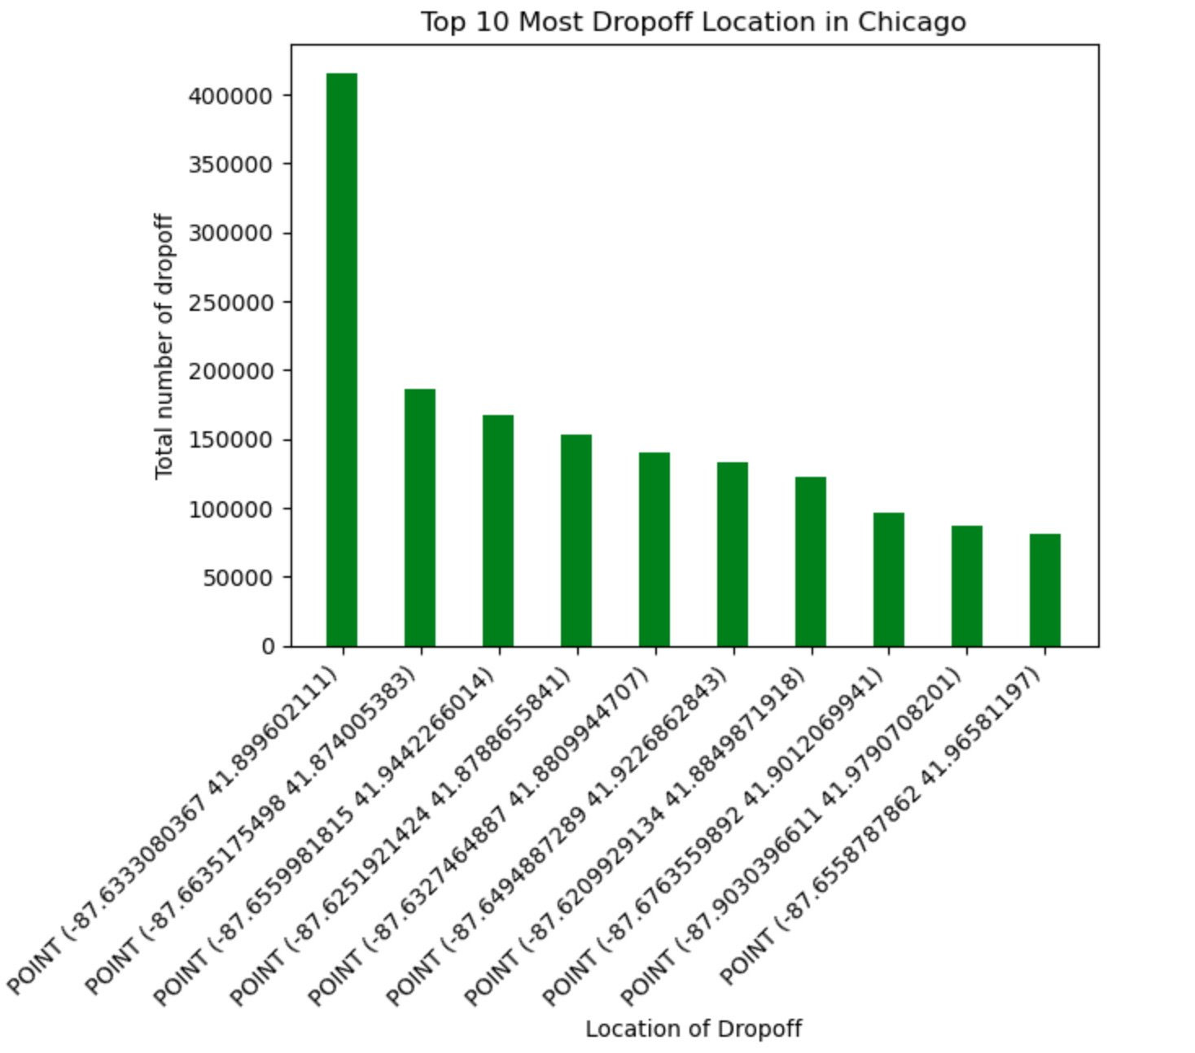
Top 10 Most Drop off Geo-coordinate in year 2021
Total numbers of drop-off at geo-coordinate (-87.63330803, 41.89960211) is 400,000 in a year 2021
This coordinate is exactly the same as that of most picked up location

Slide 8
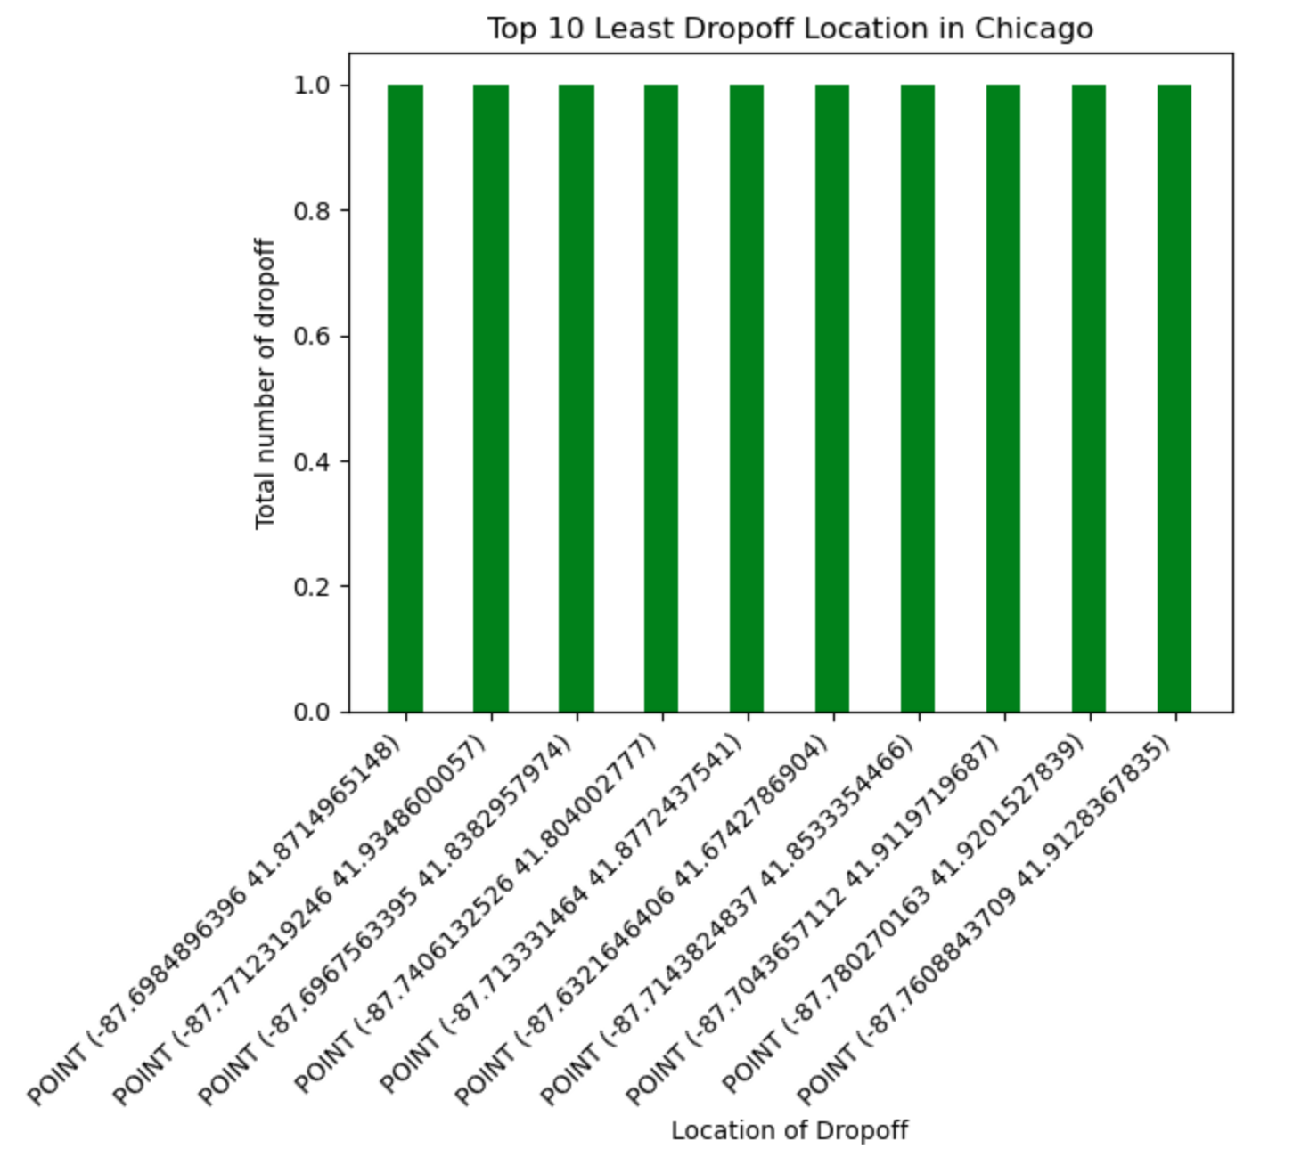
Top 10 Least Drop off Geo-coordinate in year 2021
Certain locations have only 1 drop off by far throughout the year 2021

Slide 9
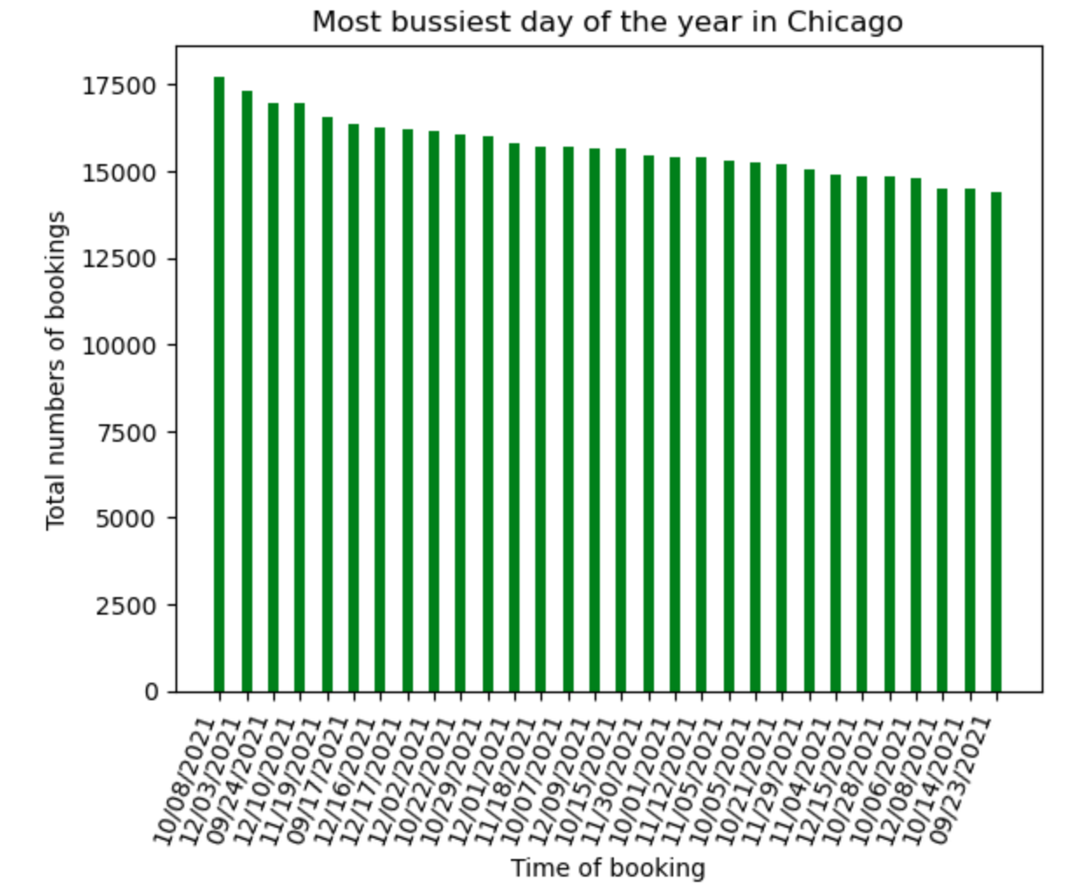
Top 30 Most busiest day of year 2021
8th October is the most busiest day of the year with the total booking of more than 17,500 in a single day, followed by 3rd December and 24th September
December have to most busiest traffic of the year, with 9 days in to 30 busiest days
The 4th quarter remains the busiest time of the year due to several holidays including new year’s eve, Christmas, halloween etc

Slide 10
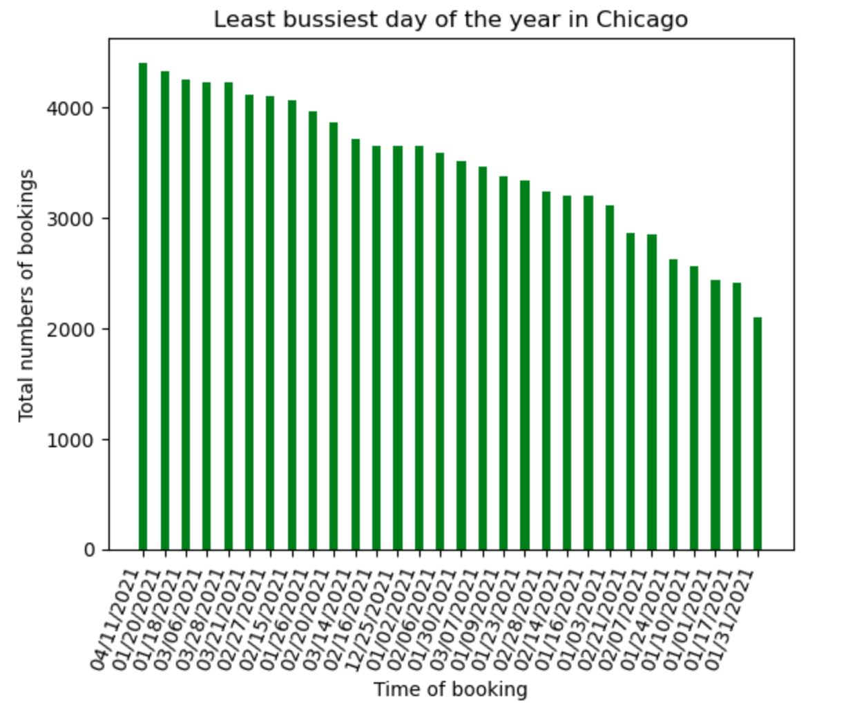
Top 30 Least busiest day of year 2021
31st January is the least busiest time of the year with only 2000 bookings a day.

Slide 11
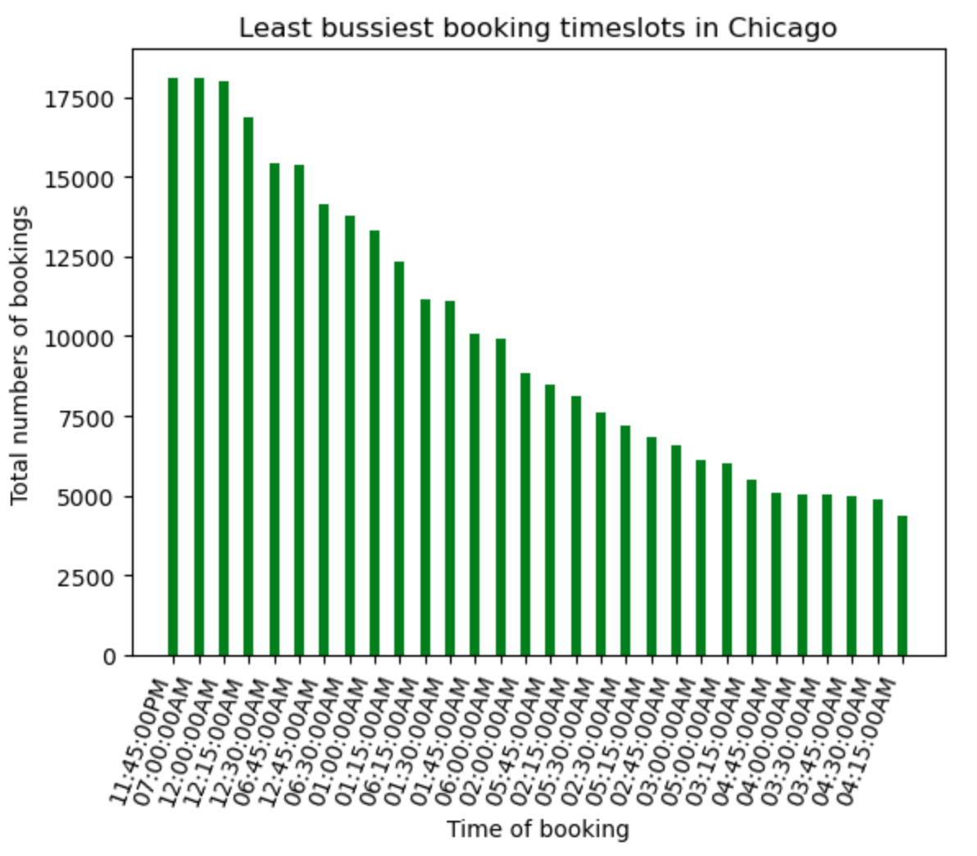
Top 30 Least busiest hour of the day in 2021
Least busiest timeslot in a given day is at around 04:00 AM
This can be attributed because most people are not at work and must be sleeping

Slide 12
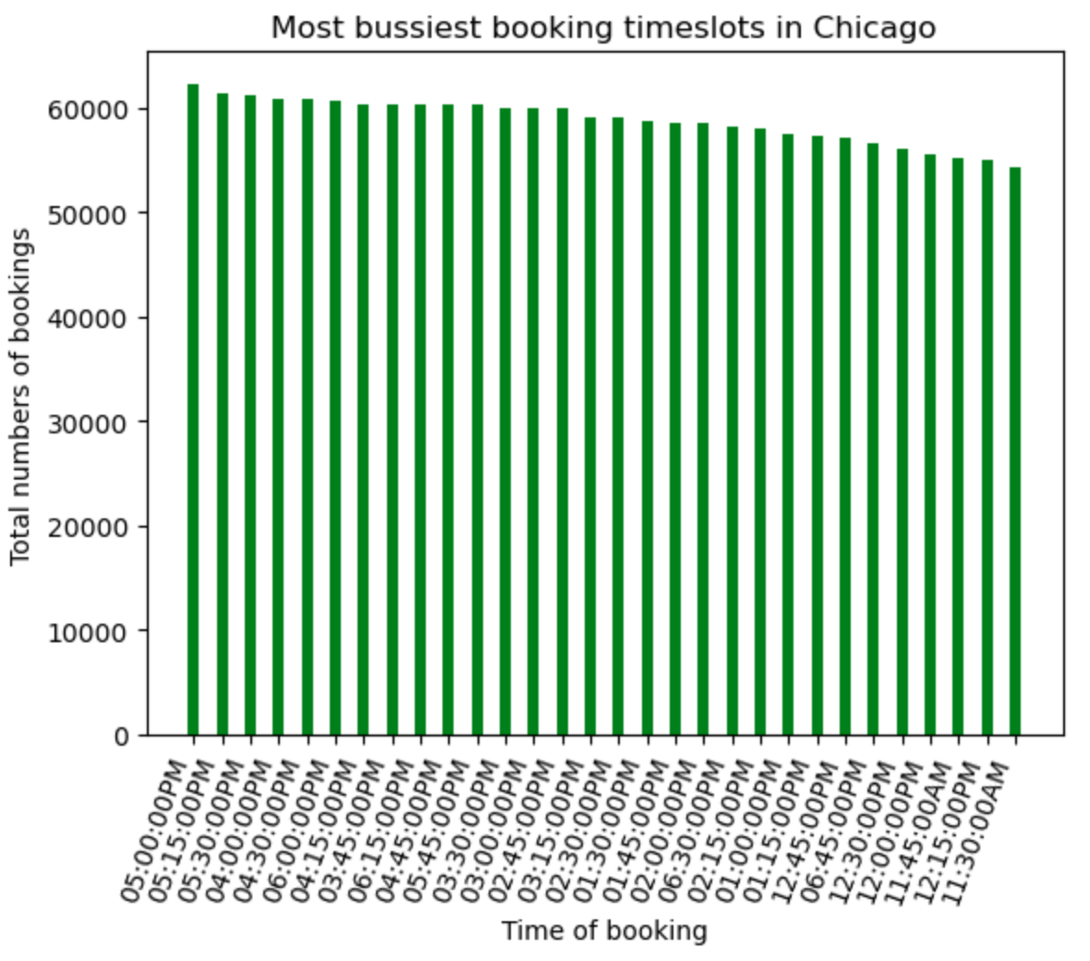
Top 30 Most busiest hour of the day in 2021
Primarily the most busiest hour of the days is at 05:00 PM
This can be attributed due to off office hours in Chicago (State of Illinois)

Slide 13
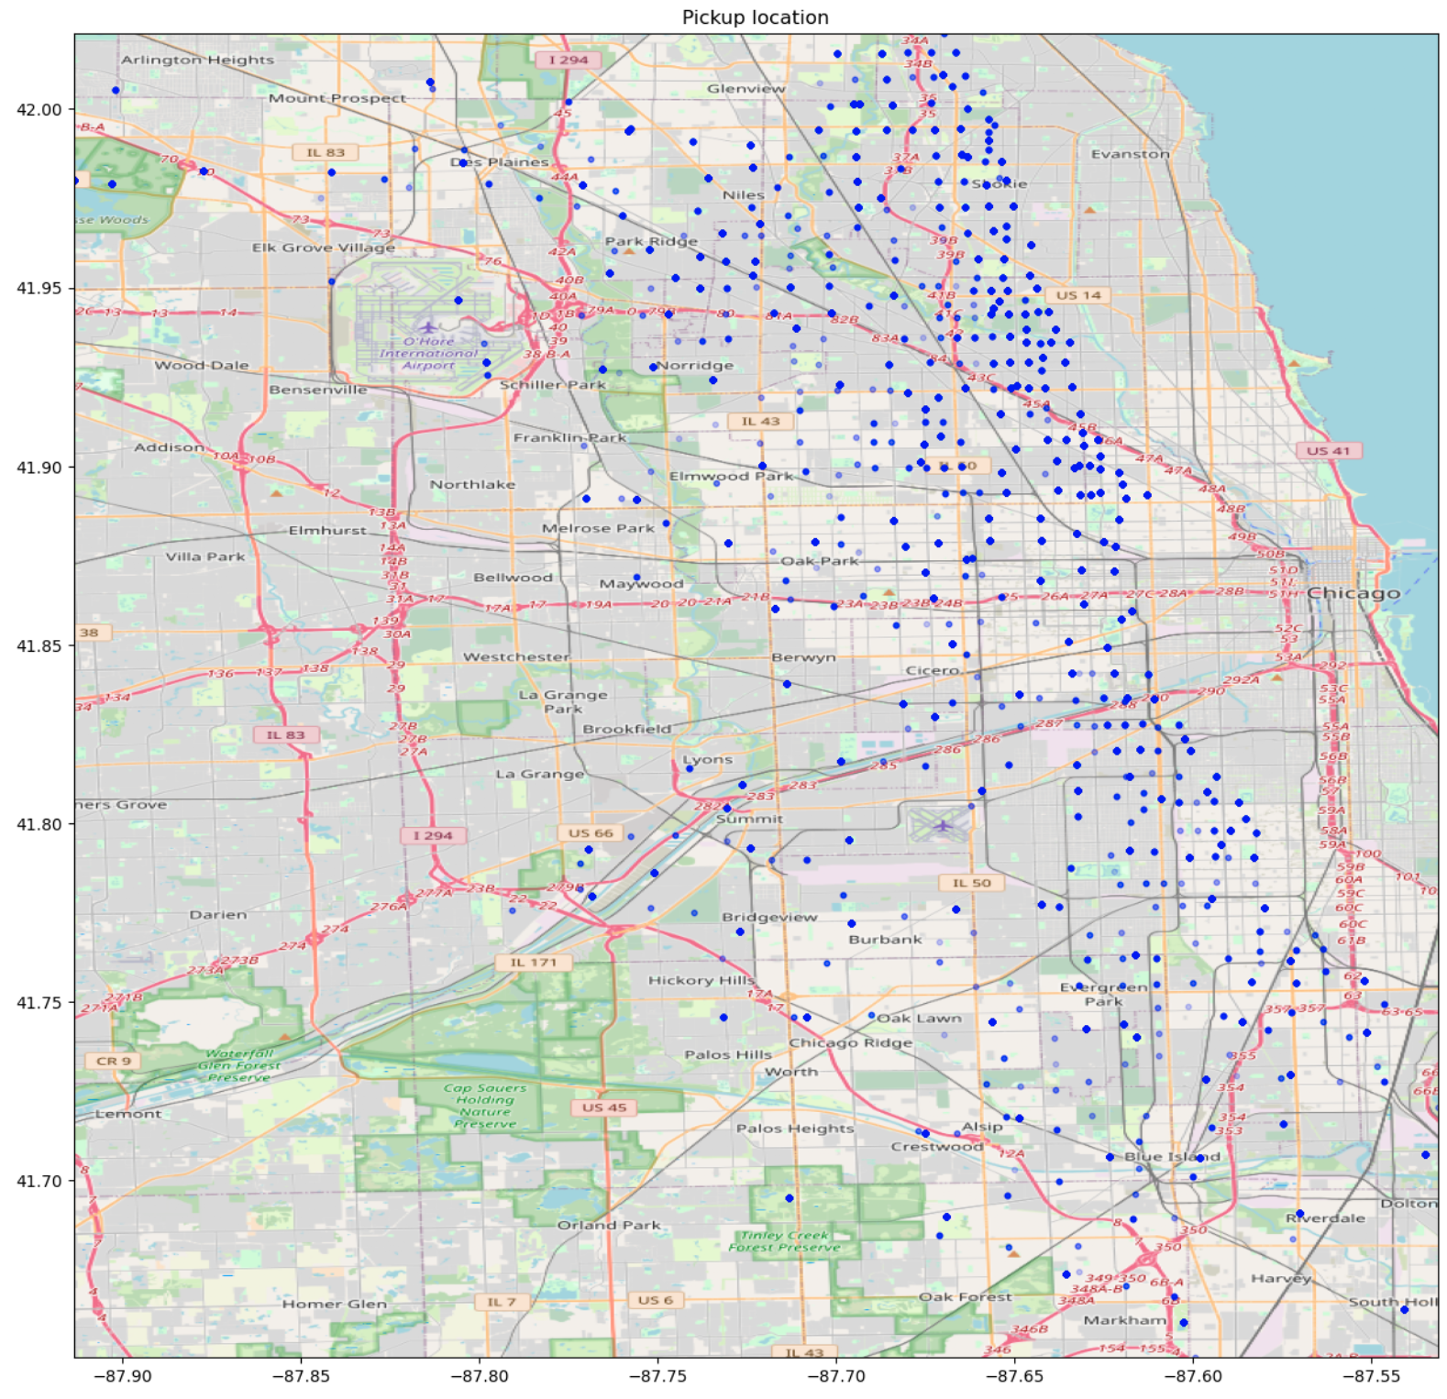
Pickup spots in the city of Chicago
Lincoln Park and Cloud gate is the most crowded area in Chicago due to its central location and Downtown area.

Slide 14
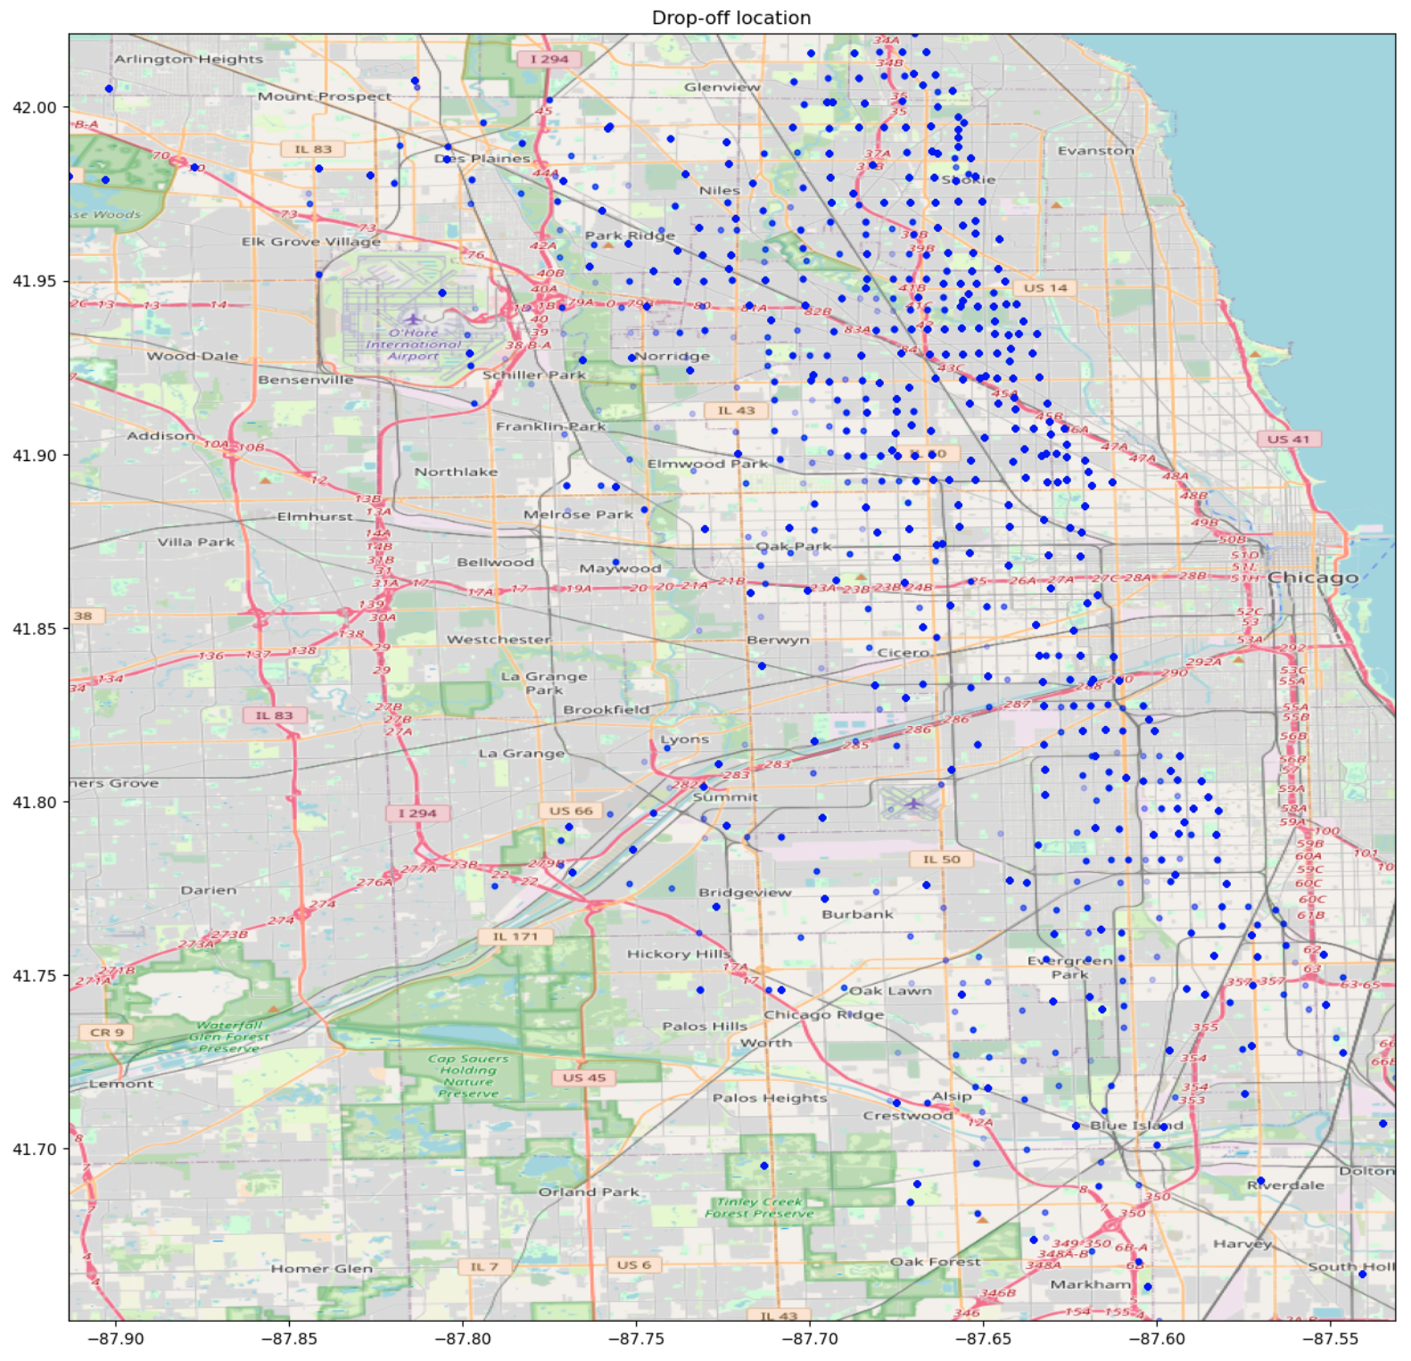
Dropoff spots in the city of Chicago

Slide 15
Animated Routes in the city of Chicago, 2021
Since the Video is long and file size is very heavy, the daily routes of a traffic is uploaded to YouTube at https://youtu.be/gTZDwMr4SpA

